Slide 1
Regular Expressions
LECTURE 12
Using string methods and regular expressions to work with textual data
Sean Kang

Slide 2
Goals For This Lecture
Working With Text Data
Canonicalizing text data.
Extracting data from text.
Using split.
Using regular expressions.

Slide 3
String Canonicalization
Notes:
canonicalization is the process of translating every string character to its single valid byte sequence. An alternative to canonicalization is to reject any strings containing invalid byte sequences.

Slide 4
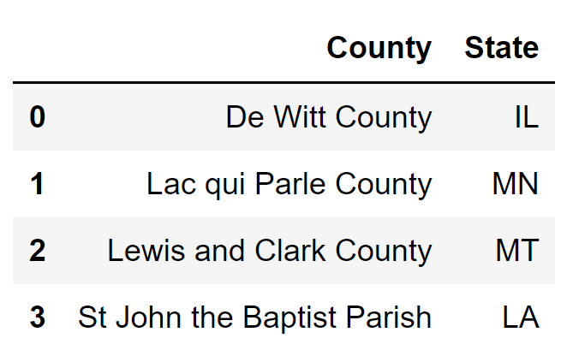
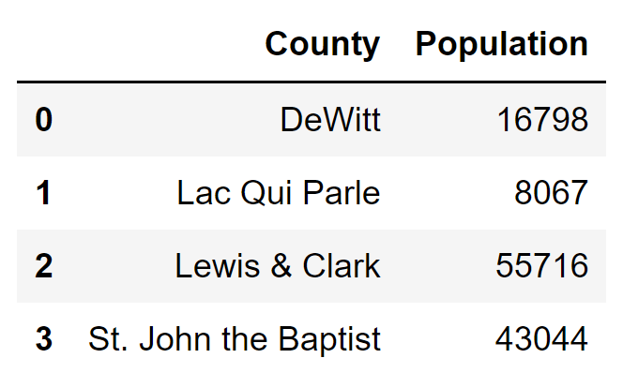
Goal 1: Joining Tables with Mismatched Labels
join
???

Slide 5
A Joining Problem
join
To join our tables we’ll need to canonicalize the county names.
Canonicalize: Convert data that has more than one possible presentation into a standard form.
???

Slide 6
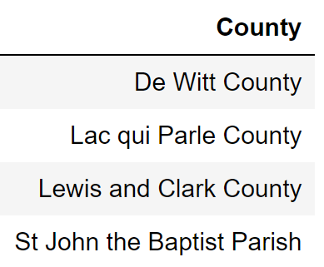
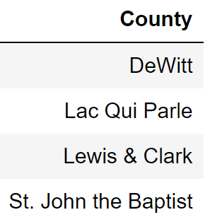
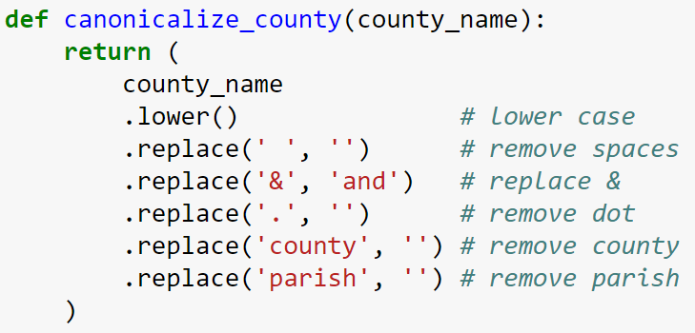
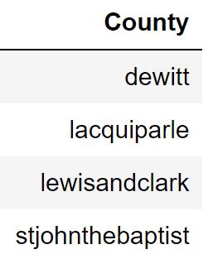
Canonicalizing County Names

Slide 7
Canonicalization
Canonicalization:
Replace each string with a unique representation.
Feels very “hacky”, but messy problems often have messy solutions.
Can be done slightly better but not by much →
Code is very brittle! Requires maintenance.
Tools used:
Replacement | str.replace(‘&’, ‘and’)
Deletion | str.replace(‘ ‘, ‘’)
Transformation | str.lower()

Slide 8
Extracting From Text Using Split

Slide 9
Goal 2: Extracting Date Information
Suppose we want to extract times and dates from web server logs that look like the following:
169.237.46.168 - - [26/Jan/2014:10:47:58 -0800] "GET /stat141/Winter04/ HTTP/1.1" 200 2585 "http://anson.ucdavis.edu/courses/"

Slide 10
Goal 2: Extracting Date Information
Suppose we want to extract times and dates from web server logs that look like the following:
There are existing libraries that do most of the work for us, but let’s try to do it from scratch.
Will do together, just a little bit at a time.
169.237.46.168 - - [26/Jan/2014:10:47:58 -0800] "GET /stat141/Winter04/ HTTP/1.1" 200 2585 "http://anson.ucdavis.edu/courses/"

Slide 11
Extracting Date Information
169.237.46.168 - - [26/Jan/2014:10:47:58 -0800] "GET /stat141/Winter04/ HTTP/1.1" 200 2585 "http://anson.ucdavis.edu/courses/"
One possible solution:

Slide 12
Extracting Date Information
169.237.46.168 - - [26/Jan/2014:10:47:58 -0800] "GET /stat141/Winter04/ HTTP/1.1" 200 2585 "http://anson.ucdavis.edu/courses/"
One possible solution:
What if webserver changes log formats, or has a bug?
⇒ This solution breaks!! (brittle)

Slide 13
Regular Expression Basics

Slide 14
Extracting Date Information
Earlier we saw that we can hack together code that uses split to extract info:
An alternate approach is to use a so-called “regular expression”:
Implementation provided in the re library built into Python.
We’ll spend some time today working up to expressions like shown below.
26/Jan/2014:10:47:58 -0800

Slide 15
Regular Expressions
A formal language is a set of strings, typically described implicitly.
Example: “The set of all strings of length < 10 that contain ‘horse’”
A regular language is a formal language that can be described by a regular expression (which we will define soon).
Example: [0-9]{3}-[0-9]{2}-[0-9]{4}
3 of any digit, then a dash, then 2 of any digit, then a dash, then 4 of any digit.
The language of SSNs is described by this regular expression.
text = "My social security number is 123-45-6789.";
pattern = r"[0-9]{3}-[0-9]{2}-[0-9]{4}"
re.findall(pattern, text)

Slide 16
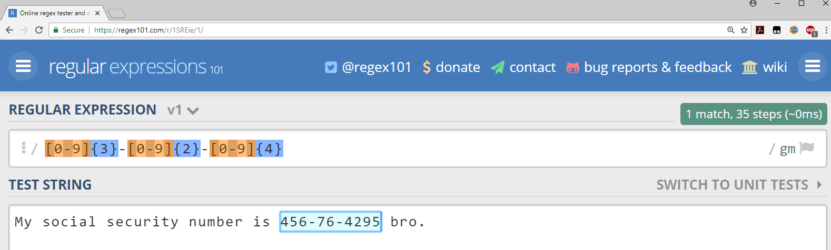
Regex101.com (or the online tutorial regexone.com)
There are a ton of nice resources out there to experiment with regular expressions (e.g. regex101.com, regexone.com, sublime text, python, etc).
I recommend trying out regex101.com, which provides a visually appealing and easy to use platform for experimenting with regular expressions.
Example: https://regex101.com/r/1SREie/1

Slide 17
Regular Expression Syntax
The four basic operations for regular expressions.
Can technically do anything with just these basic four (albeit tediously).
operation | order | example | matches | does not match
concatenation | 3 | AABAAB | AABAAB | every other string
or | 4 | AA|BAAB | AA BAAB | every other string
closure (zero or more) | 2 | AB*A | AA ABBBBBBA | AB ABABA
parenthesis | 1 | A(A|B)AAB | AAAAB ABAAB | every other string
 |  | (AB)*A | A ABABABABA | AA ABBA
Notes:
Table adapted from our Algorithms textbook: http://www.cs.princeton.edu/courses/archive/spring17/cos226/lectures/54RegularExpressions.pdf

Slide 18
Regular Expression Syntax
AB*: A then zero or more copies of B: A, AB, ABB, ABBB
(AB)*: Zero or more copies of AB: ABABABAB, ABAB, AB,
Matches the empty string!
operation | order | example | matches | does not match
concatenation | 3 | AABAAB | AABAAB | every other string
or | 4 | AA|BAAB | AA BAAB | every other string
closure (zero or more) | 2 | AB*A | AA ABBBBBBA | AB ABABA
parenthesis | 1 | A(A|B)AAB | AAAAB ABAAB | every other string
 |  | (AB)*A | A ABABABABA | AA ABBA
Notes:
Table adapted from our Algorithms textbook: http://www.cs.princeton.edu/courses/archive/spring17/cos226/lectures/54RegularExpressions.pdf

Slide 19
Puzzle: Use regex101.com to test! Or tinyurl.com/reg913z
Give a regular expression that matches moon, moooon, etc. Your expression should match any even number of o’s except zero (i.e. don’t match mn).

Slide 20
Puzzle Solution
Solution to puzzle on previous slide: moo(oo)*n

Slide 21
Regular Expression moo(oo)*n: https://tinyurl.com/reg913m
Give a regex that matches muun, muuuun, moon, moooon, etc. Your expression should match any even number of u’s or o’s except zero (i.e. don’t match mn).

Slide 22
Puzzle Solution
Solution to puzzle on previous slide: m(uu(uu)*|oo(oo)*)n
Note: m(uu(uu)*)|(oo(oo)*)n is not correct! OR must be in parentheses!

Slide 23
Order of Operations in Regexes
m(uu(uu)*|oo(oo)*)n
Matches starting with m and ending with n, with either of the following in the middle:
uu(uu)*
oo(oo)*
Match examples:
muun
muuuun
moon
moooon

Slide 24
Order of Operations in Regexes
m(uu(uu)*|oo(oo)*)n
Matches starting with m and ending with n, with either of the following in the middle:
uu(uu)*
oo(oo)*
m(uu(uu)*)|(oo(oo)*)n
Matches either of the following
m followed by uu(uu)*
m followed by oo(oo)*
In regexes | comes last.
Match examples:
muun
muuuun
moon
moooon
Match examples:
muu
muuuu
oon
oooon

Slide 25
Expanded Regular Expressions Syntax

Slide 26
Expanded Regex Syntax
operation | example | matches | does not match
any character (except newline) | .U.U.U. | CUMULUS JUGULUM | SUCCUBUS TUMULTUOUS
character class | [A-Za-z][a-z]* | word Capitalized | camelCase 4illegal
at least one | jo+hn | john joooooohn | jhn jjohn
zero or one | joh?n | jon john | any other string
repeated exactly {a} times | j[aeiou]{3}hn | jaoehn jooohn | jhn jaeiouhn
repeated from a to b times: {a,b} | j[ou]{1,2}hn | john juohn | jhn jooohn
Notes:
Table adapted from our Algorithms textbook: http://www.cs.princeton.edu/courses/archive/spring17/cos226/lectures/54RegularExpressions.pdf

Slide 27
More Regular Expression Examples
regex | matches | does not match
.*SPB.* Zero or more char before and after SPB | RASPBERRY CRISPBREAD | SUBSPACE SUBSPECIES
[0-9]{3}-[0-9]{2}-[0-9]{4} SSN pattern match | 231-41-5121 573-57-1821 | 231415121 57-3571821
[a-z]+@([a-z]+\.)+(edu|com) Email validator | horse@pizza.com horse@pizza.food.com | frank_99@yahoo.com hug@cs
Notes:
Table adapted from our Algorithms textbook: http://www.cs.princeton.edu/courses/archive/spring17/cos226/lectures/54RegularExpressions.pdf

Slide 28
Expanded Regex Puzzle: https://tinyurl.com/reg913w
operation | example | matches | does not match
any character (except newline) | .U.U.U. | CUMULUS JUGULUM | SUCCUBUS TUMULTUOUS
character class | [A-Za-z][a-z]* | word Capitalized | camelCase 4illegal
at least one | jo+hn | john | jhn
zero or one | joh?n | jon john | any other string
repeated exactly {a} times | j[aeiou]{3}hn | jaoehn jooohn | jhn jaeiouhn
repeated from a to b times: {a,b} | j[ou]{1,2}hn | john juohn | jhn jooohn
Challenge: Give a regular expression for any lowercase string that has a repeated vowel (i.e. noon, peel, festoon, loop, etc).
Notes:
Table adapted from our Algorithms textbook: http://www.cs.princeton.edu/courses/archive/spring17/cos226/lectures/54RegularExpressions.pdf

Slide 29
Expanded Regex Puzzle Solution
Challenge: Give a regular expression for any lowercase string that has a repeated vowel (i.e. noon, peel, festoon, loop, etc): [a-z]*(aa|ee|ii|oo|uu)[a-z]*
Notes:
Table adapted from our Algorithms textbook: http://www.cs.princeton.edu/courses/archive/spring17/cos226/lectures/54RegularExpressions.pdf

Slide 30
More Advanced Regular Expressions Syntax

Slide 31
Limitations of Regular Expressions
Writing regular expressions is like writing a program.
Need to know the syntax well.
Can be easier to write than to read.
Can be difficult to debug.
Regular expressions are terrible at certain types of problems. Examples:
For parsing a hierarchical structure, such as JSON, use a parser, not a regex!
Complex features (e.g. valid email address).
Counting (same number of instances of a and b). (impossible)
Complex properties (palindromes, balanced parentheses). (impossible)

Slide 32
Email Address Regular Expression (a probably bad idea)
The regular expression for email addresses (for the Perl programming language):
(?:(?:\r\n)?[ \t])*(?:(?:(?:[^()<>@,;:\\".\[\] \000-\031]+(?:(?:(?:\r\n)?[ \t])+|\Z|(?=[\["()<>@,;:\\".\[\]]))|"(?:[^\"\r\\]|\\.|(?:(?:\r\n)?[ \t]))*"(?:(?: \r\n)?[ \t])*)(?:\.(?:(?:\r\n)?[ \t])*(?:[^()<>@,;:\\".\[\] \000-\031]+(?:(?:(?:\r\n)?[ \t])+|\Z|(?=[\["()<>@,;:\\".\[\]]))|"(?:[^\"\r\\]|\\.|(?:(?:\r\n)?[ \t]))*"(?:(?:\r\n)?[ \t])*))*@(?:(?:\r\n)?[ \t])*(?:[^()<>@,;:\\".\[\] \000-\031]+(?:(?:(?:\r\n)?[ \t])+|\Z|(?=[\["()<>@,;:\\".\[\]]))|\[([^\[\]\r\\]|\\.)*\ ](?:(?:\r\n)?[ \t])*)(?:\.(?:(?:\r\n)?[ \t])*(?:[^()<>@,;:\\".\[\] \000-\031]+(?:(?:(?:\r\n)?[ \t])+|\Z|(?=[\["()<>@,;:\\".\[\]]))|\[([^\[\]\r\\]|\\.)*\](?: (?:\r\n)?[ \t])*))*|(?:[^()<>@,;:\\".\[\] \000-\031]+(?:(?:(?:\r\n)?[ \t])+|\Z|(?=[\["()<>@,;:\\".\[\]]))|"(?:[^\"\r\\]|\\.|(?:(?:\r\n)?[ \t]))*"(?:(?:\r\n) ?[ \t])*)*\<(?:(?:\r\n)?[ \t])*(?:@(?:[^()<>@,;:\\".\[\] \000-\031]+(?:(?:(?:\r\n)?[ \t])+|\Z|(?=[\["()<>@,;:\\".\[\]]))|\[([^\[\]\r\\]|\\.)*\](?:(?:\r\n)?[ \t])*)(?:\.(?:(?:\r\n)?[ \t])*(?:[^()<>@,;:\\".\[\] \000-\031]+(?:(?:(?:\r\n)?[ \t])+|\Z|(?=[\["()<>@,;:\\".\[\]]))|\[([^\[\]\r\\]|\\.)*\](?:(?:\r\n)?[ \t] )*))*(?:,@(?:(?:\r\n)?[ \t])*(?:[^()<>@,;:\\".\[\] \000-\031]+(?:(?:(?:\r\n)?[ \t])+|\Z|(?=[\["()<>@,;:\\".\[\]]))|\[([^\[\]\r\\]|\\.)*\](?:(?:\r\n)?[ \t])* )(?:\.(?:(?:\r\n)?[ \t])*(?:[^()<>@,;:\\".\[\] \000-\031]+(?:(?:(?:\r\n)?[ \t])+|\Z|(?=[\["()<>@,;:\\".\[\]]))|\[([^\[\]\r\\]|\\.)*\](?:(?:\r\n)?[ \t])*))*) *:(?:(?:\r\n)?[ \t])*)?(?:[^()<>@,;:\\".\[\] \000-\031]+(?:(?:(?:\r\n)?[ \t])+|\Z|(?=[\["()<>@,;:\\".\[\]]))|"(?:[^\"\r\\]|\\.|(?:(?:\r\n)?[ \t]))*"(?:(?:\r \n)?[ \t])*)(?:\.(?:(?:\r\n)?[ \t])*(?:[^()<>@,;:\\".\[\] \000-\031]+(?:(?:(?:\r\n)?[ \t])+|\Z|(?=[\["()<>@,;:\\".\[\]]))|"(?:[^\"\r\\]|\\.|(?:(?:\r\n)?[ \t ]))*"(?:(?:\r\n)?[ \t])*))*@(?:(?:\r\n)?[ \t])*(?:[^()<>@,;:\\".\[\] \000-\031]+(?:(?:(?:\r\n)?[ \t])+|\Z|(?=[\["()<>@,;:\\".\[\]]))|\[([^\[\]\r\\]|\\.)*\]( ?:(?:\r\n)?[ \t])*)(?:\.(?:(?:\r\n)?[ \t])*(?:[^()<>@,;:\\".\[\] \000-\031]+(?:(?:(?:\r\n)?[ \t])+|\Z|(?=[\["()<>@,;:\\".\[\]]))|\[([^\[\]\r\\]|\\.)*\](?:(? :\r\n)?[ \t])*))*\>(?:(?:\r\n)?[ \t])*)|(?:[^()<>@,;:\\".\[\] \000-\031]+(?:(?:(?:\r\n)?[ \t])+|\Z|(?=[\["()<>@,;:\\".\[\]]))|"(?:[^\"\r\\]|\\.|(?:(?:\r\n)? [ \t]))*"(?:(?:\r\n)?[ \t])*)*:(?:(?:\r\n)?[ \t])*(?:(?:(?:[^()<>@,;:\\".\[\] \000-\031]+(?:(?:(?:\r\n)?[ \t])+|\Z|(?=[\["()<>@,;:\\".\[\]]))|"(?:[^\"\r\\]| \\.|(?:(?:\r\n)?[ \t]))*"(?:(?:\r\n)?[ \t])*)(?:\.(?:(?:\r\n)?[ \t])*(?:[^()<>@,;:\\".\[\] \000-\031]+(?:(?:(?:\r\n)?[ \t])+|\Z|(?=[\["()<>@,;:\\".\[\]]))|" (?:[^\"\r\\]|\\.|(?:(?:\r\n)?[ \t]))*"(?:(?:\r\n)?[ \t])*))*@(?:(?:\r\n)?[ \t])*(?:[^()<>@,;:\\".\[\] \000-\031]+(?:(?:(?:\r\n)?[ \t])+|\Z|(?=[\["()<>@,;:\\ ".\[\]]))|\[([^\[\]\r\\]|\\.)*\](?:(?:\r\n)?[ \t])*)(?:\.(?:(?:\r\n)?[ \t])*(?:[^()<>@,;:\\".\[\] \000-\031]+(?:(?:(?:\r\n)?[ \t])+|\Z|(?=[\["()<>@,;:\\".\[ \]]))|\[([^\[\]\r\\]|\\.)*\](?:(?:\r\n)?[ \t])*))*|(?:[^()<>@,;:\\".\[\] \000-\031]+(?:(?:(?:\r\n)?[ \t])+|\Z|(?=[\["()<>@,;:\\".\[\]]))|"(?:[^\"\r\\]|\\.|( ?:(?:\r\n)?[ \t]))*"(?:(?:\r\n)?[ \t])*)*\<(?:(?:\r\n)?[ \t])*(?:@(?:[^()<>@,;:\\".\[\] \000-\031]+(?:(?:(?:\r\n)?[ \t])+|\Z|(?=[\["()<>@,;:\\".\[\]]))|\[([ ^\[\]\r\\]|\\.)*\](?:(?:\r\n)?[ \t])*)(?:\.(?:(?:\r\n)?[ \t])*(?:[^()<>@,;:\\".\[\] \000-\031]+(?:(?:(?:\r\n)?[ \t])+|\Z|(?=[\["()<>@,;:\\".\[\]]))|\[([^\[\ ]\r\\]|\\.)*\](?:(?:\r\n)?[ \t])*))*(?:,@(?:(?:\r\n)?[ \t])*(?:[^()<>@,;:\\".\[\] \000-\031]+(?:(?:(?:\r\n)?[ \t])+|\Z|(?=[\["()<>@,;:\\".\[\]]))|\[([^\[\]\ r\\]|\\.)*\](?:(?:\r\n)?[ \t])*)(?:\.(?:(?:\r\n)?[ \t])*(?:[^()<>@,;:\\".\[\] \000-\031]+(?:(?:(?:\r\n)?[ \t])+|\Z|(?=[\["()<>@,;:\\".\[\]]))|\[([^\[\]\r\\] |\\.)*\](?:(?:\r\n)?[ \t])*))*)*:(?:(?:\r\n)?[ \t])*)?(?:[^()<>@,;:\\".\[\] \000-\031]+(?:(?:(?:\r\n)?[ \t])+|\Z|(?=[\["()<>@,;:\\".\[\]]))|"(?:[^\"\r\\]|\\ .|(?:(?:\r\n)?[ \t]))*"(?:(?:\r\n)?[ \t])*)(?:\.(?:(?:\r\n)?[ \t])*(?:[^()<>@,;:\\".\[\] \000-\031]+(?:(?:(?:\r\n)?[ \t])+|\Z|(?=[\["()<>@,;:\\".\[\]]))|"(? :[^\"\r\\]|\\.|(?:(?:\r\n)?[ \t]))*"(?:(?:\r\n)?[ \t])*))*@(?:(?:\r\n)?[ \t])*(?:[^()<>@,;:\\".\[\] \000-\031]+(?:(?:(?:\r\n)?[ \t])+|\Z|(?=[\["()<>@,;:\\". \[\]]))|\[([^\[\]\r\\]|\\.)*\](?:(?:\r\n)?[ \t])*)(?:\.(?:(?:\r\n)?[ \t])*(?:[^()<>@,;:\\".\[\] \000-\031]+(?:(?:(?:\r\n)?[ \t])+|\Z|(?=[\["()<>@,;:\\".\[\] ]))|\[([^\[\]\r\\]|\\.)*\](?:(?:\r\n)?[ \t])*))*\>(?:(?:\r\n)?[ \t])*)(?:,\s*(?:(?:[^()<>@,;:\\".\[\] \000-\031]+(?:(?:(?:\r\n)?[ \t])+|\Z|(?=[\["()<>@,;:\\ ".\[\]]))|"(?:[^\"\r\\]|\\.|(?:(?:\r\n)?[ \t]))*"(?:(?:\r\n)?[ \t])*)(?:\.(?:(?:\r\n)?[ \t])*(?:[^()<>@,;:\\".\[\] \000-\031]+(?:(?:(?:\r\n)?[ \t])+|\Z|(?=[ \["()<>@,;:\\".\[\]]))|"(?:[^\"\r\\]|\\.|(?:(?:\r\n)?[ \t]))*"(?:(?:\r\n)?[ \t])*))*@(?:(?:\r\n)?[ \t])*(?:[^()<>@,;:\\".\[\] \000-\031]+(?:(?:(?:\r\n)?[ \t ])+|\Z|(?=[\["()<>@,;:\\".\[\]]))|\[([^\[\]\r\\]|\\.)*\](?:(?:\r\n)?[ \t])*)(?:\.(?:(?:\r\n)?[ \t])*(?:[^()<>@,;:\\".\[\] \000-\031]+(?:(?:(?:\r\n)?[ \t])+| \Z|(?=[\["()<>@,;:\\".\[\]]))|\[([^\[\]\r\\]|\\.)*\](?:(?:\r\n)?[ \t])*))*|(?:[^()<>@,;:\\".\[\] \000-\031]+(?:(?:(?:\r\n)?[ \t])+|\Z|(?=[\["()<>@,;:\\".\[\ ]]))|"(?:[^\"\r\\]|\\.|(?:(?:\r\n)?[ \t]))*"(?:(?:\r\n)?[ \t])*)*\<(?:(?:\r\n)?[ \t])*(?:@(?:[^()<>@,;:\\".\[\] \000-\031]+(?:(?:(?:\r\n)?[ \t])+|\Z|(?=[\[" ()<>@,;:\\".\[\]]))|\[([^\[\]\r\\]|\\.)*\](?:(?:\r\n)?[ \t])*)(?:\.(?:(?:\r\n)?[ \t])*(?:[^()<>@,;:\\".\[\] \000-\031]+(?:(?:(?:\r\n)?[ \t])+|\Z|(?=[\["()<> @,;:\\".\[\]]))|\[([^\[\]\r\\]|\\.)*\](?:(?:\r\n)?[ \t])*))*(?:,@(?:(?:\r\n)?[ \t])*(?:[^()<>@,;:\\".\[\] \000-\031]+(?:(?:(?:\r\n)?[ \t])+|\Z|(?=[\["()<>@, ;:\\".\[\]]))|\[([^\[\]\r\\]|\\.)*\](?:(?:\r\n)?[ \t])*)(?:\.(?:(?:\r\n)?[ \t])*(?:[^()<>@,;:\\".\[\] \000-\031]+(?:(?:(?:\r\n)?[ \t])+|\Z|(?=[\["()<>@,;:\\ ".\[\]]))|\[([^\[\]\r\\]|\\.)*\](?:(?:\r\n)?[ \t])*))*)*:(?:(?:\r\n)?[ \t])*)?(?:[^()<>@,;:\\".\[\] \000-\031]+(?:(?:(?:\r\n)?[ \t])+|\Z|(?=[\["()<>@,;:\\". \[\]]))|"(?:[^\"\r\\]|\\.|(?:(?:\r\n)?[ \t]))*"(?:(?:\r\n)?[ \t])*)(?:\.(?:(?:\r\n)?[ \t])*(?:[^()<>@,;:\\".\[\] \000-\031]+(?:(?:(?:\r\n)?[ \t])+|\Z|(?=[\[ "()<>@,;:\\".\[\]]))|"(?:[^\"\r\\]|\\.|(?:(?:\r\n)?[ \t]))*"(?:(?:\r\n)?[ \t])*))*@(?:(?:\r\n)?[ \t])*(?:[^()<>@,;:\\".\[\] \000-\031]+(?:(?:(?:\r\n)?[ \t]) +|\Z|(?=[\["()<>@,;:\\".\[\]]))|\[([^\[\]\r\\]|\\.)*\](?:(?:\r\n)?[ \t])*)(?:\.(?:(?:\r\n)?[ \t])*(?:[^()<>@,;:\\".\[\] \000-\031]+(?:(?:(?:\r\n)?[ \t])+|\Z |(?=[\["()<>@,;:\\".\[\]]))|\[([^\[\]\r\\]|\\.)*\](?:(?:\r\n)?[ \t])*))*\>(?:(?:\r\n)?[ \t])*))*)?;\s*)
From: http://www.ex-parrot.com/~pdw/Mail-RFC822-Address.html

Slide 33
Even More Regular Expression Syntax
operation | example | matches | does not match
built-in character classes | \w+ \d+ | fawef 231231 | this person 423 people
character class negation | [^a-z]+ | PEPPERS3982 17211!↑å | porch
escape character | cow\.com | cow.com | cowscom
Suppose you want to match one of our special characters like: . [ ]
In these cases, you must “escape” the character using the backslash.
You can think of the backslash as meaning “take this next character literally”.

Slide 34
Regular Expressions Puzzle: tinyurl.com/reg913a
Create a regular expression that matches the red portion below.
169.237.46.168 - - [26/Jan/2014:10:47:58 -0800] "GET /stat141/Winter04/ HTTP/1.1" 200 2585 "http://anson.ucdavis.edu/courses/"

Slide 35
Regular Expressions Puzzle Solution: tinyurl.com/reg913a
Create a regular expression that matches the red portion below: \[.*\]
169.237.46.168 - - [26/Jan/2014:10:47:58 -0800] "GET /stat141/Winter04/ HTTP/1.1" 200 2585 "http://anson.ucdavis.edu/courses/"
See example in lab file

Slide 36
Even More Regular Expression Features
operation | example | matches | does not match
beginning of line | ^ark | ark two ark o ark | dark
end of line | ark$ | dark ark o ark | ark two
lazy version of zero or more *? | 5.*?5 | 5005 55 | 5005005
5.*5 would match this!
A few additional common regex features are listed above.
Won’t discuss these in class, but might come up in discussion or hw.
There are even more out there!
The official guide is good! https://docs.python.org/3/howto/regex.html

Slide 37
Regular Expressions in Python
(and Regex Groups)

Slide 38
re.findall in Python
In Python, re.findall(pattern, text) will return a list of all matches.
text = "My social security number is 456-76-4295 bro, or actually maybe it’s 456-67-4295.";
pattern = r"[0-9]{3}-[0-9]{2}-[0-9]{4}"
m = re.findall(pattern, text)
print(m)
['456-76-4295', '456-67-4295']

Slide 39
Regular Expression Groups
Earlier we used parentheses to specify the order of operations.
Parenthesis have another meaning:
Every set of parentheses specifies a so-called “group”.
Regular expression matchers (e.g. re.findall, regex101.com) will return matches organized by groups. In Python, returned as tuples.
s = """Observations: 03:04:53 - Horse awakens.
03:05:14 - Horse goes back to sleep."""
pattern = "(\d\d):(\d\d):(\d\d) - (.*)"
matches = re.findall(pattern, s)
[('03', '04', '53', 'Horse awakens.'),
('03', '05', '14', 'Horse goes back to sleep.')]
Notes:
Table adapted from our Algorithms textbook: http://www.cs.princeton.edu/courses/archive/spring17/cos226/lectures/54RegularExpressions.pdf

Slide 40
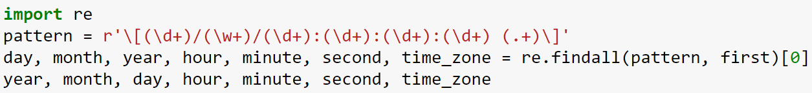
Extracting Date Information
With a little more work, we can do something similar and extract day, month, year, hour, minutes, seconds, and time zone all in one regular expression.
Derivation is left as an exercise for you
You will also see code that uses re.search instead of re.findall.

Slide 41
Case Studies on Police Data and Restaurant Data

Slide 42
Summary
Today we saw many different string manipulation tools.
There are many many more!
With just this basic set of tools, you can do most of what you’ll need.
basic python | re | pandas
 | re.findall | df.str.findall
str.replace | re.sub | df.str.replace
str.split | re.split | df.str.split
’ab’ in str | re.search | df.str.contain
len(str) |  | df.str.len
str[1:4] |  | df.str[1:4]

